Slide 1
Resideo Reporting Guide
Process for reporting POS and INV
March/2023

Slide 2
BENEFITS TO YOUR ORGANIZATION
With your data, Resideo can provide better support to you and your customers.
Contractors are rewarded for purchasing qualifying Resideo products
With Point-of-Sale data, Resideo will award loyalty points to contractors (based on their purchases through your organization) which, in turn, drives loyalty to your business
Data becomes actionable
With Point-of-Sale data, your organization can work strategically with your Resideo Sales Rep to drive sales downstream
With Inventory data, Resideo can gain visibility into the supply chain and will be better positioned to serve you with product availability
Single collection point for data submitted to Resideo
Standardized format
Minimized human intervention as much as possible

Slide 3
POS DATA BEING REQUESTED
Distributor POS
Distributor Name
Distributor Location Number
Distributor Warehouse Name
Distributor Warehouse City
Distributor Warehouse State
Distributor Warehouse Country
Distributor SKU Number
Distributor Unit Cost
Distributor Total Amount
Contractor Information
Contractor Loyalty Number
Contractor Name
Contractor Address
Contractor City
Contractor State
Contractor Postal Code
Contractor Country
Transaction Information
Invoice Number
Invoice Date
Resideo SKU Number
Quantity Sold
Contractor Unit Price
Contractor Total Amount
Currency Being Reported

Slide 4
INV DATA BEING REQUESTED
Distributor INV
Distributor Name
Distributor Location Number
Distributor Warehouse Postal Code
Distributor Warehouse Country
Resideo SKU Number
Distributor SKU Number
Inventory Date/Snapshot Date
Quantity Available
Quantity Allocated
Quantity Total
On Order Total
Distributor’s Average Unit Cost
Currency Being Reported

Slide 5
DATA SUBMISSION REQUIREMENTS
February
Point-of-Sale Report Due Date: February 7th
Reporting is due at 10am CST
on the 7th business day of each month
Format: Machine-Readable
With separate columns headings that match the template format
With field/data points listed in separate columns
In specified file format: Excel, CSV, or Flat File (CSV, Pipe delimited)
Frequency:
10am CST on the 7th calendar data of each month
Point-of-Sale (POS): The point-of-sale data should be for the entire month
Inventory: the inventory snapshot should be taken as of the last calendar day of each month

Slide 6
TWO DATA SUBMISSION OPTIONS
With your data, Resideo can provide better support to you and your customers.
Email to resideo_files@o9solutions.com
Upload to the o9 Solution secure FTP site (requires individual Distributor’s FTP account creation)
Submission options listed above are to be used after your test POS and INV data file(s) have been reviewed and accepted by o9 Solutions. Once you have received a “clear to send notice” from o9 Solutions, you can submit your monthly POS and INV reports via one of these options.

Slide 7
PROCESS for On-Boarding
We will need reporting for any Resideo, Genesis Cable and BRK (First Alert) Products.
The file format should be Excel, CSV, or Flat File (CSV, Pipe delimited)
Step 1: Provide test reports based on the templates, this helps accurately map your data fields
Email to Channeldata@resideo.com
Step 2: We will review the reports to identify gaps in the reporting structure
Step 3: We will work with you to correct gaps
Step 4: The o9 Solutions team will conduct UAT testing on the file
Step 5: We will notify with “clear to send” email that contains all the details to start your monthly reporting

Slide 8
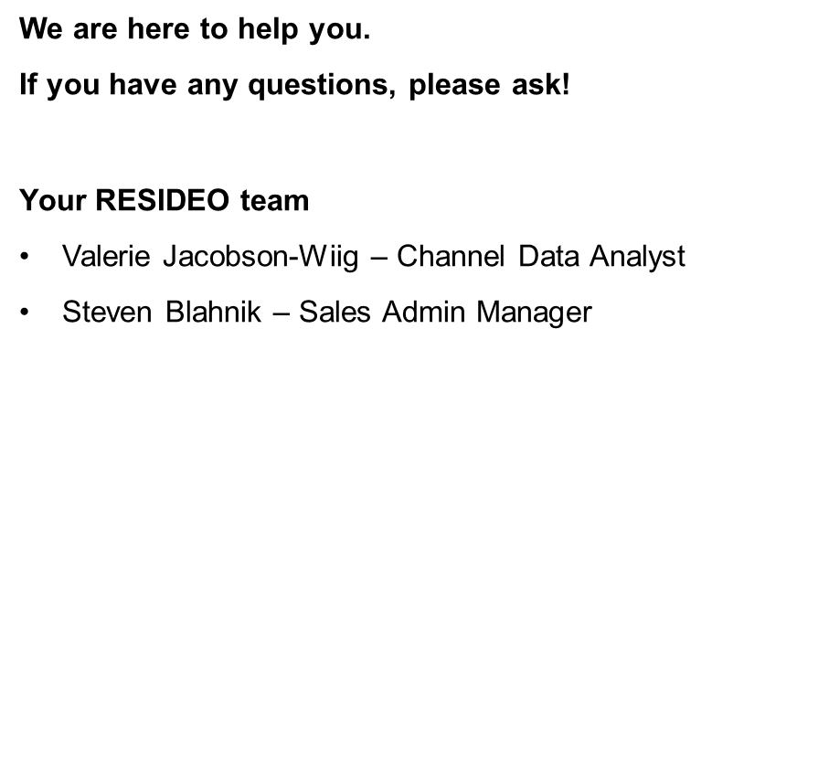
QUESTIONS

